Slide 1









WORKSHOPS
Build Production-Ready Applications With Langchain - Part 1
Zero Shot Labs x San Francisco AI User Group
Daryle Serrant
Data Scientist & ML Consultant
byteSolid Solutions

Slide 2
Objective
By the end of this workshop, you will be able to do the following:
Learn core concepts of LangChain
Create an OpenAI-powered LLM chatbot
Learn how to use LangChain for orchestrating prompt chains

Slide 3

Table of Contents / Agenda
1
Tech Overview
20 Minutes
2
Hands-On Practice
20 Minutes
3
Quiz
10 Questions
4
Q & A

Slide 4
Prerequisites
Before this workshop starts, you’ll need:
OpenAI API key
Basic familiarity with prompting/large language models
Basic familiarity with Python

Slide 5


Tech Overview

Slide 6

What is LangChain?
Framework for developing LLM applications
Addresses a variety of LLM building needs
Used by startups and industry leaders alike
Notes:
What is LangChain?
LangChain is a framework for developing production-grade LLM applications
Provides components and utilities that address a wide range of needs when building with LLMs
Used by start-ups and industry leaders alike to build powerful and reliable LLM applications

Slide 7
Why use LangChain?
Maintainable - Changing code is easy and safe.
Readable - Fewer lines of code.
Reliable - Community-tested and robust.
Notes:
Why use LangChain?
In a production environment, code must be maintainable, readable, and reliable.
Maintainable - LangChain’s modularity makes changing code easy and safe.
Readable - LangChain’s utilities result in fewer lines of code.
Reliable - Use community-tested, robust components.

Slide 8
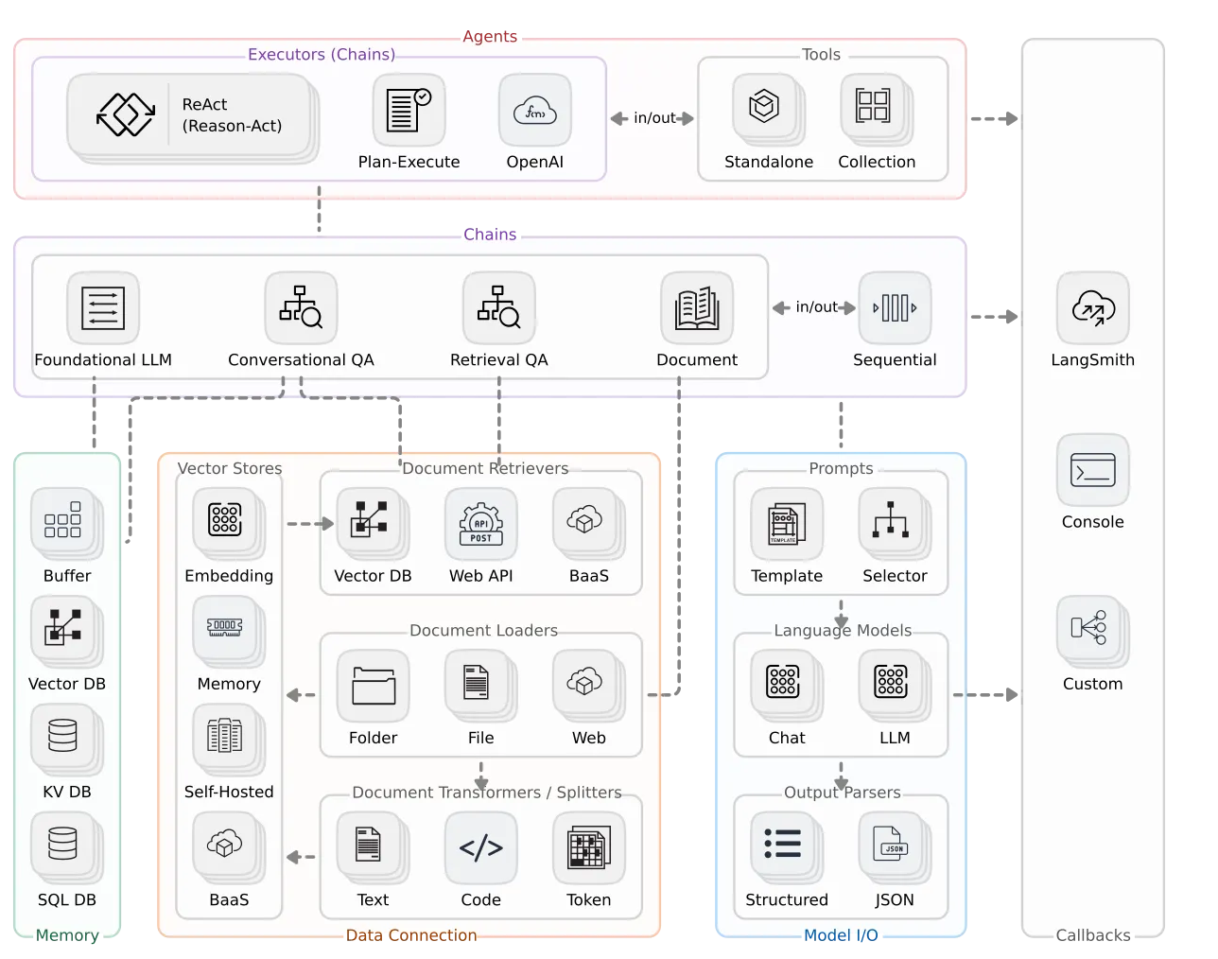
LangChain Ecosystem
Chains
Prompts
Memory
Language Models

Slide 9
Project Overview
Build chatbot using LangChain, GPT 3.5 Turbo, and Gradio
Notes:
Project Overview:
Today, we will be building our own custom chatbot using LangChain, GPT 3.5 Turbo, and Gradio.
First, let’s review some of the LangChain components we’ll be using.

Slide 10
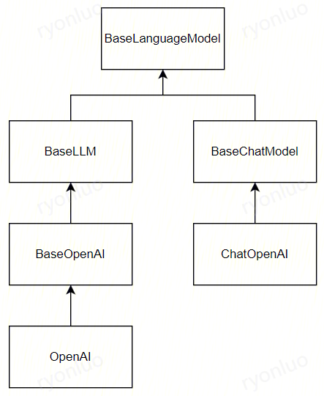
Language Models
Completion Models
Chat Models
Notes:
Language Models in LangChain
There are two main types of language models in LangChain:
Completion Models
Chat Models
These provide an abstraction layer so that one can easily interchange LLM providers (e.g., Anthropic vs. OpenAI)

Slide 11
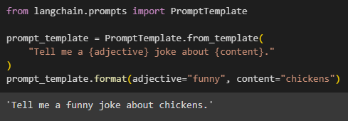
PromptTemplates
Notes:
LangChain’s PromptTemplates provide a structured format for the prompts that you use throughout your application (e.g., defining the format string and all of the input variables).

Slide 12
PromptTemplates
Notes:
LangChain’s PromptTemplates provide a structured format for the prompts that you use throughout your application (e.g., defining the format string and all of the input variables).

Slide 13
PromptTemplates Types
PromptTemplate
ChatPromptTemplate
Notes:
Note on PromptTemplate Types
LangChain’s PromptTemplates enable composition of modular prompts.
Like models, PromptTemplates come in two flavors:
PromptTemplate
ChatPromptTemplate
In this workshop, we will use a `ChatPromptTemplate`.

Slide 14
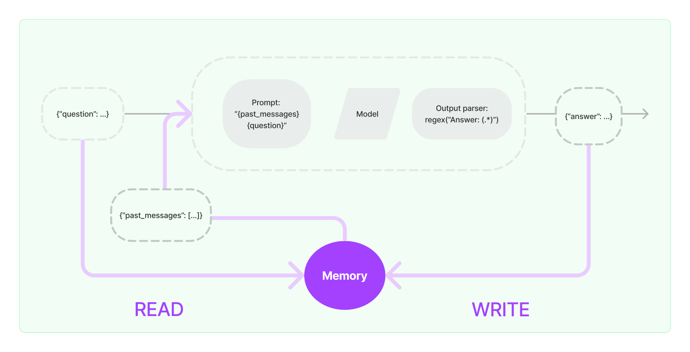
Memory
Notes:
Memory
When calling an LLM, the model won’t remember the message history by default. LangChain’s Memory object provides an abstraction that you can include in your chain to keep track of this history.

Slide 15
Putting It All Together
http://tinyurl.com/ZSL-langchain

Slide 16
Getting Started with LangChain

Slide 17
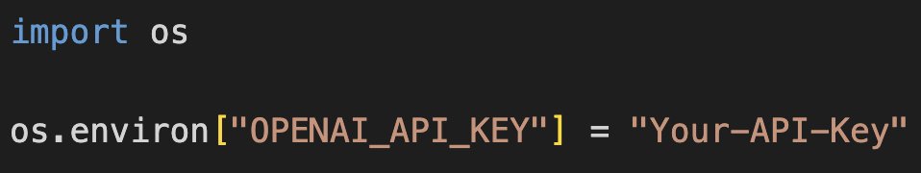
Getting Started
Install the required package
`pip install openai langchain gradio`
Store your OpenAI API key:
`os.environ[“OPENAI_API_KEY”] = ”[Your-API-Key]”`

Slide 18
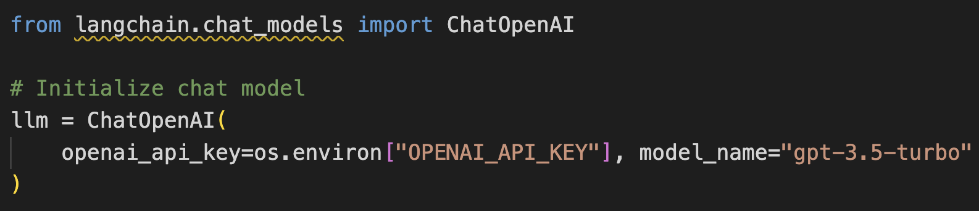
Model
Initializing a model in LangChain is easy.
Since we are building a chatbot, let’s use the `ChatOpenAI` model.

Slide 19
Prompt
Now, we will use `ChatPromptTemplate` to build our prompt.
First, we will define a “system” message to provide the model with context about its task and how it should respond.
Second, we will provide a `MessagePlaceholder` for the chat memory. More on this later. For now, note the “history” variable name.
Last, we will provide a placeholder for the human’s response.

Slide 20
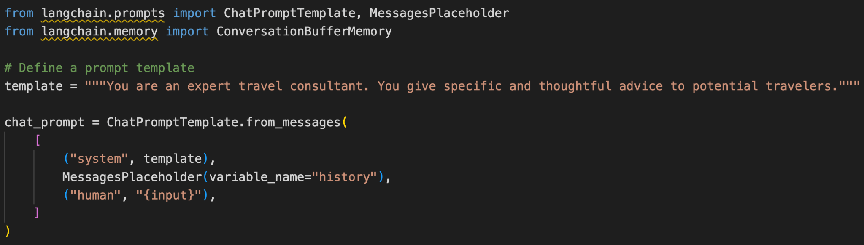
Prompt (cont.)
Note that we provide this full prompt to `GPT-3.5-Turbo` every time we request a response.
OpenAI’s API has no memory of prior requests.

Slide 21
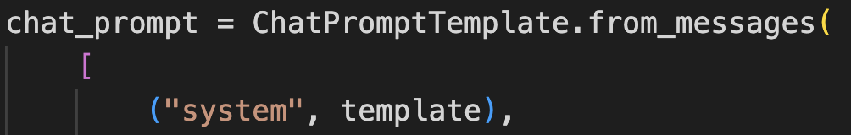
Messages
LangChain’s “chat” components use `Messages`. From the previous slide:
A Message has two components:
The speaker’s role (“system”)
Their message
In our case, `(“system”, template)` takes the place of a `SystemMessage`.

Slide 22
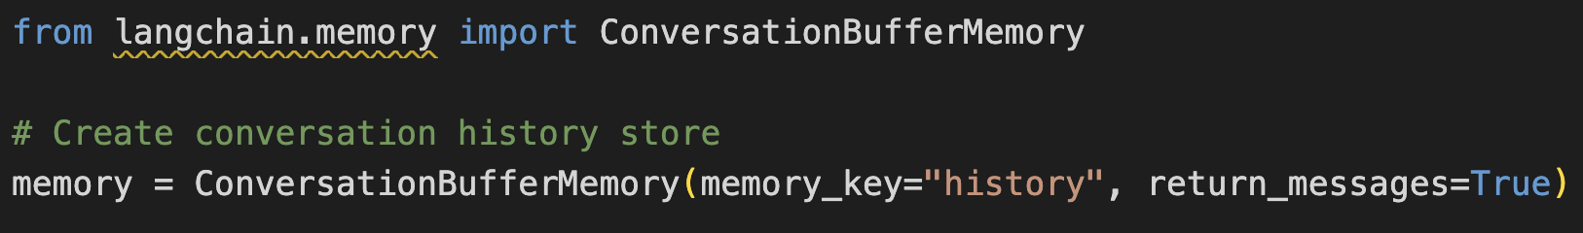
Initialize Memory
Our chain will use this memory to store the conversation history, and then insert it into our prompt whenever we call the chain.
The “history” memory key tells our memory to replace the MessagePlaceholder in the prompt with the contents of the memory.

Slide 23
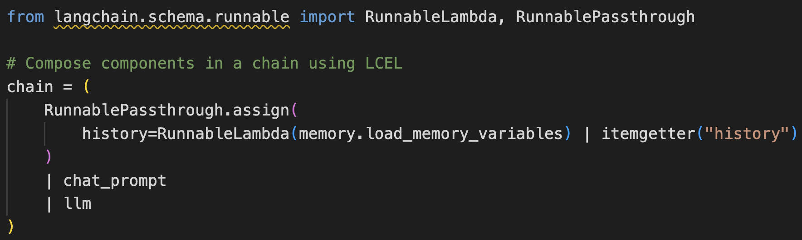
LangChain Expression Language
LangChain provides a convenient syntax they call the LangChain Expression Language (LCEL). Essentially, this is a powerful and easy way to combine components into a custom chain.

Slide 24
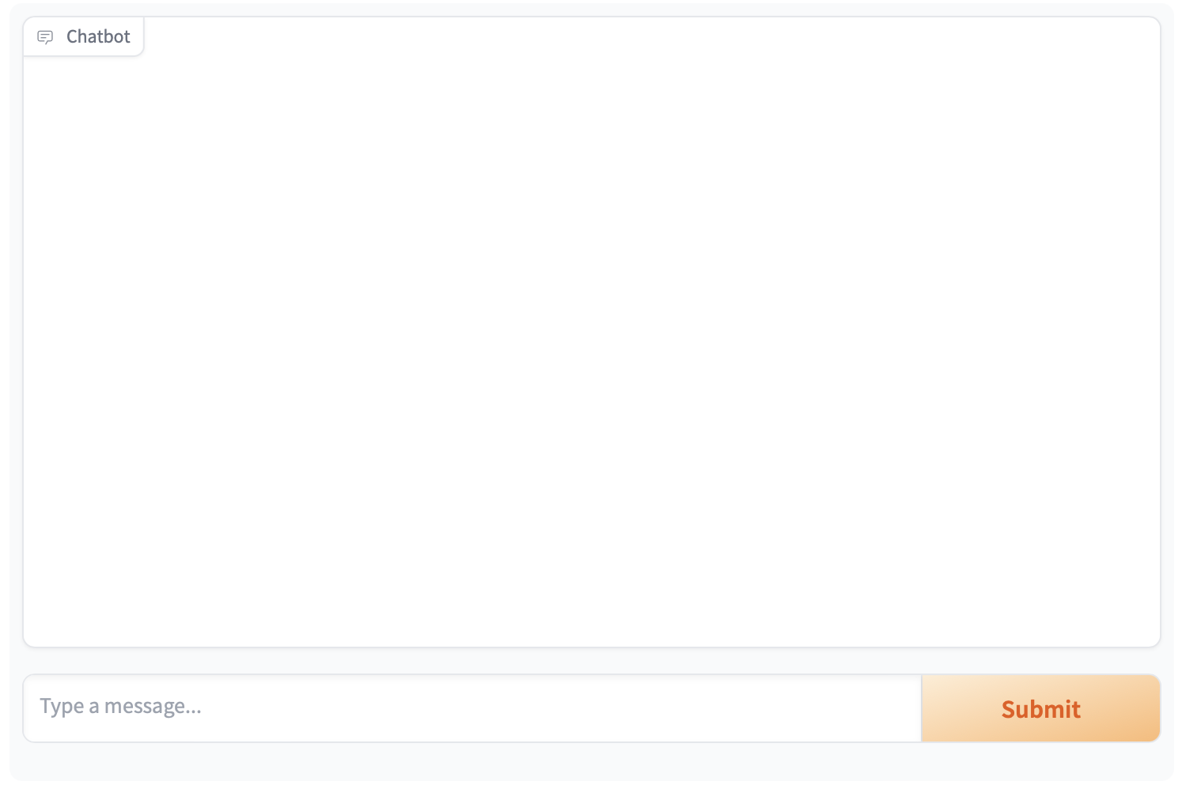
Gradio Frontend
Gradio is a fast and powerful Python library used to create data-centric front-ends on the web.
Gradio’s `ChatInterface` requires one line of code!

Slide 25
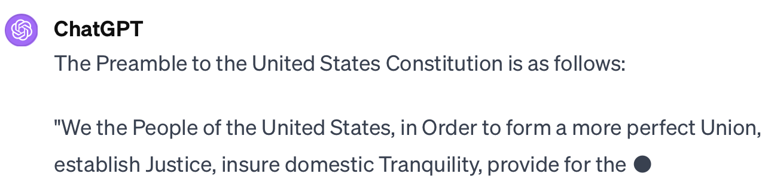
“Streaming”
If you’ve used ChatGPT, you’re familiar with a feature called “streaming”. This is when ChatGPT displays its response one chunk at a time:
LangChain and Gradio let us easily implement streaming in our chatbot.

Slide 26
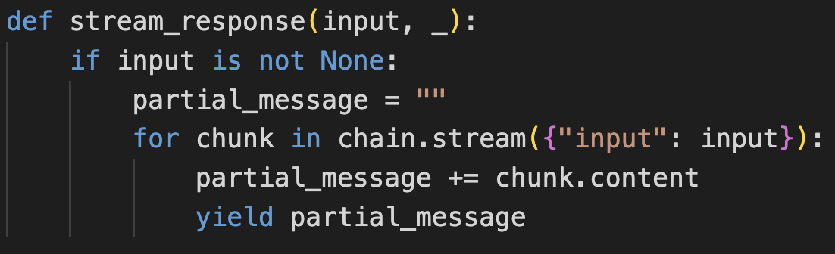
Response Function
To stream our responses via Gradio’s `ChatInterface`, we must implement our response function as a generator.
LCEL supports the necessary syntax:

Slide 27
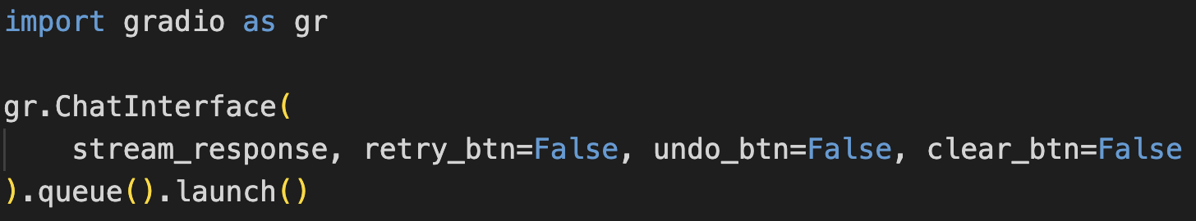
Chat Interface
Now, we simply initialize the chat interface:
The `queue()` method is what enables `ChatInterface` to display each response requested from `stream_response`.
That’s it! We’re ready to test.

Slide 28
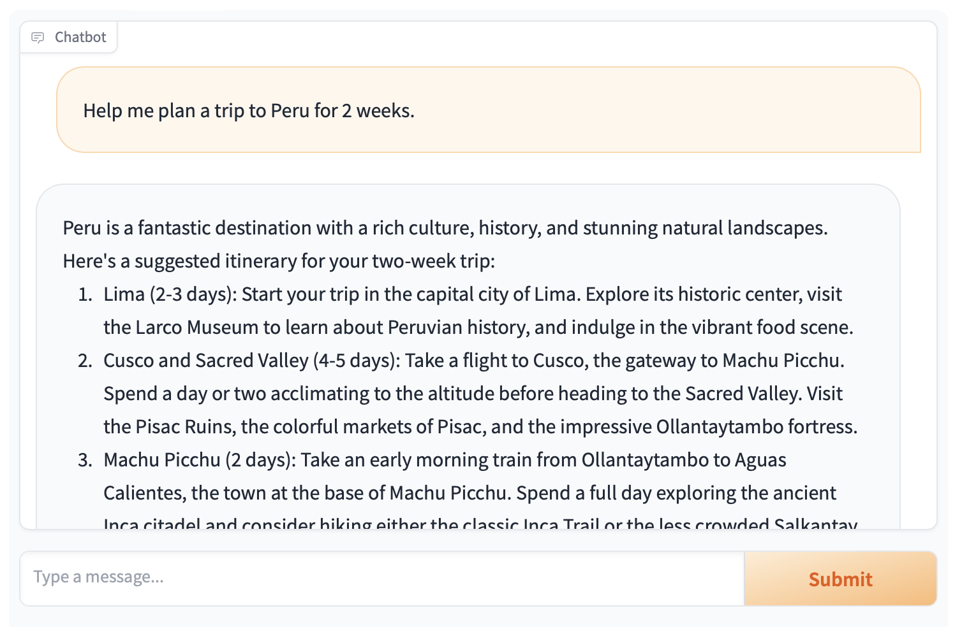
Test & Share
Gradio produces a shareable link that is valid for 72 hours. Simply copy and paste to share!

Slide 29
Example Code
Prompt Chain for Comedian App
Prompt 1: LLM writes premises for jokes.
Prompt 2: Combine these jokes into a storyboard.
Prompt 3: With this storyboard, write the final joke.

Slide 30
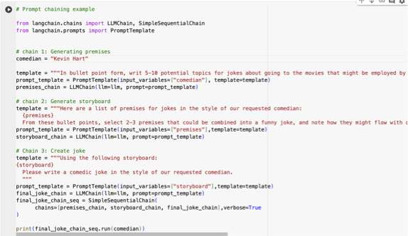
Code for this Joke Chain

Slide 31
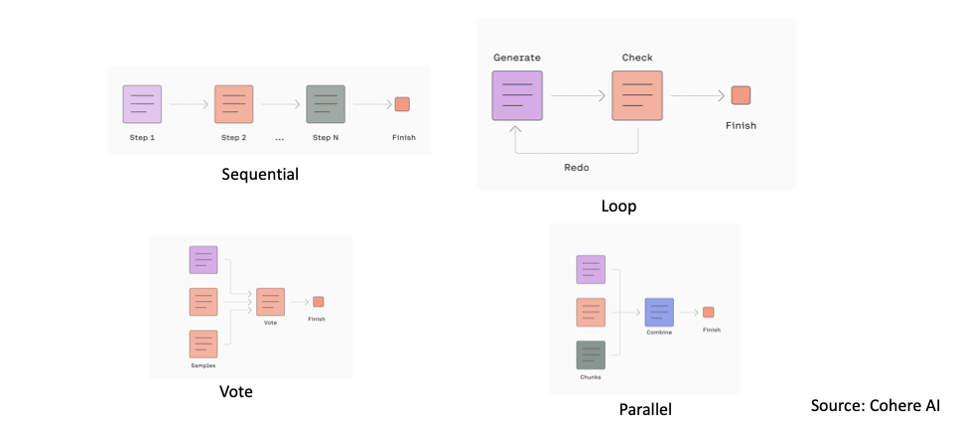
Prompt Chaining Approaches

Slide 32
Prewritten Chains Available
Summarization chains
Retrieval chains (chains that look stuff up)
Memory chains (keeps track of chat history)
And dozens more… see https://www.langchain.com/

Slide 33
Hands-On Practice

Slide 34
Final Exercise
Create a financial advisor chatbot
Write simple chain for creating poems about McDonald’s
(More instructions in Google Drive)
20 minutes to complete exercise

Slide 35
Final Exercise
http://tinyurl.com/ZSL-langchain
File > “Save a copy in Drive”
Scroll down to the last cell
Fill in your solution!

Slide 36
Q & A

Slide 37
Thank You!
pquigley@zerioshotlabs.com

Slide 38
Quiz

Slide 39
Question 1
Which of these is not a commonly-used object in LangChain?
A. BaseLLM
B. BaseChatModel
C. BaseTemplateModel

Slide 40
Question 1 - Answer
Which of these is not a commonly-used object in LangChain?
A. BaseLLM
B. BaseChatModel
C. BaseTemplateModel

Slide 41
Question 2
Which prompt template may be useful in cases where an LLM gives more accurate outputs after a couple of examples of how to approach a task?
A. RAGPromptTemplate
B. FewShotPromptTemplate
C. ZeroShotPromptTemplate

Slide 42
Question 2 - Answer
Which prompt template may be useful in cases where an LLM gives more accurate outputs after a couple of examples of how to approach a task?
A. RAGPromptTemplate
B. FewShotPromptTemplate
C. ZeroShotPromptTemplate

Slide 43
Question 3
Which prompt chaining strategy is effective in cases where an LLM may need to make several rounds of revisions before arriving at an acceptable answer?
A. Loop
B. Vote
C. Parallel

Slide 44
Question 3 - Answer
Which prompt chaining strategy is effective in cases where an LLM may need to make several rounds of revisions before arriving at an acceptable answer?
A. Loop
B. Vote
C. Parallel

Slide 45
Question 4
Which method is responsible for enabling the ChatInterface to display stream responses in a gradio chat application?
A. launch()
B. queue()
C. ChatInterface()

Slide 46
Question 4 - Answer
Which method is responsible for enabling the ChatInterface to display stream responses in a gradio chat application?
A. launch()
B. queue()
C. ChatInterface()

Slide 47
Question 5
Which of the following features of LangChain enables users to create complex chains while writing less code?
A. Memory
B. RunnableChain
C. LangChain Expression Language

Slide 48
Question 5 - Answer
Which of the following features of LangChain enables users to create complex chains while writing less code?
A. Memory
B. RunnableChain
C. LangChain Expression Language

